Slide 1
CS3220 Processor Design
Prof. Hyesoon Kim
Slides are based on
Prof. Prvulovic’s CS3220

Slide 2
Now, programming FPGA
We will use verilog for this course
We will use Xilinix tool chains
Later in the semester, we will use high-level language tool which coverts normal C/C++ program to hardware description language by compilers.

Slide 3
What is Verilog?
Hardware description language (HDL)
For designing and modeling hardware
Behavioral or algorithmic level
Highest level of abstraction. Similar to C
E.g.) you can use if-else
Other hardware description languages
VHDL
SystemC
High-level languages
Palnitkar’s Verilog HDL

Slide 4
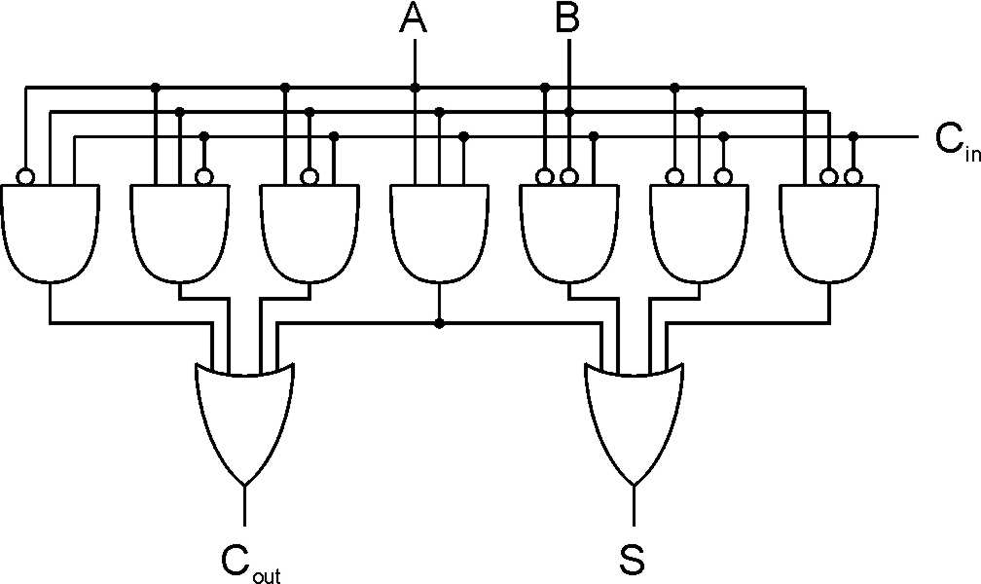
CAD Flow
Verilog
input a, b;
output [1:0] sum;
assign sum = a+b;
Compilations and synthesis
Netlist
g1 “and” n1 n2 n5
g2 “and” n3 n4 n6
g3 “or” n5 n6 n7 …
Mapping
FPGA
ASIC
(Custom ICs)

Slide 5
Verilog?
Gate-level
Modules are implemented in terms of logics and interconnections (gates and wires)
Switch level
Lowest level of abstraction. Switches, storage nodes
Palnitkar’s Verilog HDL

Slide 6
Components of a Verilog Module
Module Name,
Port List, Port Declarations (if ports present)
Parameters (optional)
Declarations of wires, regs and other variables
Data flow statement (assign)
Always and initial blocks,
All behavioral statements go in these blocks
Instantiation of lower level modules
Tasks and functions
endmodule statement
Palnitkar’s Verilog HDL

Slide 7
Modules
module <module name> (<list of ports>);
input <width> <input port name>;
output <width> <output port name>;
<variable declarations>
< statements> // module internals
endmodule
Module statement defines the interface
Each port has to be declared as input or output
width specified as [n-1:0] for a n-bit port
Palnitkar’s Verilog HDL

Slide 8
Ports : Connect Between Modules
Ports
Verilog keyword
Input : input port
Output: output port
Inout : bidirection port
ports
Module
Notes:
Port mismatch is one of the common errors as well

Slide 9
Simple Verilog Module
module myxor (c, a, b); // Note: List interface signals
// Declare interface signals
output c;
input a, b;
// declare internal wires
wire nota,notb,anotb,bnota;
// Describe internal circuitry
not(nota,a); // nota = not a, using not() primitive module
not(notb,b); // notb = not b
and(anotb, a, notb); // anotb = a and notb
and(bnota, b, nota); // bnota=b and nota
or(c,anotb,bnota);
endmodule

Slide 10
Instances
Instantiation
Create real objects
Every module needs to be instantiated inside another module
module myxor;
….
myxor myxor1, myxor2;
Define myxor
Instantiate 2 myxors
Notes:
A module provides a template from which you can create actual objects. When a module is invoked, verilog creates a unique object from the template.

Slide 11
Lexical Conventions
similar to C
comments: // /* */
Operators:
unary, binary, ternary
a = ~b, a = b&& c, a = b? c : d;
Operator type
Arithmetic: * / + - %
Logical: ! && ||
Relational > < >= <=
Equality == != === !==
Bitwise ! & | ^ ^~ ~^
Reduction & ~& | ~| ^ ^~ ~^

Slide 12
Reduction Operators
X = 4’b1010
&X ?
1 & 0 & 1 & 0 → 1’b0
|x ?
1 | 0 | 1 | 0 → 1’b1
^x
1^0^1^0 → 1’b0

Slide 13
Literals
<size>’<base><number>
All of the following are the same:
8’b10101111 // binary
8’hAF // hex
{4’hA, 4’b1111} // concatenation
{4’hA, {4{1’b1}}} // repeat the same signal
Verilog provides the following 4 values
0: logic zero or false condition
1: logic one, or true condition
x: unknown/undefined logic value, only for physical data types
z: high-impedance/floating state. Only for physical data types
Notes:
Data size mismatch never generated an error in the compilation!
One of the common sources of the error

Slide 14
Registers vs. Wire
Wire
Represents connection between components
Its value is determined by the value of its drivers
Its default value is z (high-impedance)
Reg
Retains its value until next assignment
Its default value is x
Reg does not mean register in the hardware. Just a variable type.
https://cs.uwaterloo.ca/~oardakan/files/Verilog-Intro.pdf

Slide 15
Conditional Operator
usage: condition_expr ? true_expr:false_expr
assign addr_bus = drive_enable? addr_out : 36’bz; // MUX behavior
assign out = control? in1: in0
assign out = (A == 3) ? (control ? X :Y) : (control ? m:n);

Slide 16
Continuous (Dataflow) Assignment
<continous_assignment>
:: = assign <drive strength>?<delay>?<list_of_assignments>;
assign out = i1 & i2; // out is a net, i1 and i2 are nets
assign addr[15:0] = addr_bits[15:0] ^ addr2_bits[15:0];
// assign for vector nets
assign {c_out, sum[3:0]} = a[3:0]+b[3:0]+c_in;
// concatenation , left-hand side is a concatenation of a scalar net and a vector net
a simple and natural way to represent combinational logic
Implicit continuous assignment
Only one implicit declaration assignment per wire
wire out;
assign out = in1 & in2;
→ wire out = in1 & in2;
Palnitkar’s Verilog HDL

Slide 17
Always Statement
Always: starts at 0, executes the statements in the always block continuously in a looping fashion
You cannot assign wires while inside an always block
the always block runs once whenever a signal in the sensitivity list changes value
always @(posedge clock)
a = b;
Statements within Always block will be run sequentially
module clock_gen;
reg clock;
initial
clock = 1’b0;
always
#10 clock = ~clock;
initial
#10000 $finish;
endmodule

Slide 18
General rules for always
Always are used for state-machines, pipeline latches.
always @(*) // always block statements are executed whenever input values are changed
Combinational logic
always @(clock)
Put latch events
CS3220 Prof. Milos Prvulovic

Slide 19
Simulation
Simulation: create all the input signals
Often means creating more Verilog code and monitors
Testbench: test-only code
Generating inputs
Unit Under Test
Checking Outputs

Slide 20
Behavioral Simulation
High-level model simulation
Before Synthesis using only HDL
Checking high-level design functional behavior
Without any timing constrains
Fromhttps://www.xilinx.com/support/documentation/sw_manuals/xilinx11/platform_studio/ps_c_sim_behavioral_simulation.htm:

